Slide 1
SC1015
Mini Project:
Diabetes
Risk Factors
Chew Zhi Yi Mark,
Teoh Xi Sheng,
Janelle Koh Wei Shan

Slide 2

Diabetes
One of the most prevalent chronic diseases in US
32.4M
TREATMENT
However
Americans have diabetes as of 2018
4 in 5 pre-diabetics
Early diagnosis → lifestyle changes and more effective treatment,
predictive models for diabetes risk are important tools for the public and public health officials
Are unaware of their risk
AREAS AFFECTED
Kidney
Heart
Sight
Feet
Notes:
-a serious chronic disease in which individuals lose the ability to effectively regulate levels of glucose in the blood → reduced quality of life and life expectancy.
After different foods are broken down into sugars during digestion → the sugars are released into the bloodstream → pancreas releases insulin.
Insulin helps enable cells within the body to use those sugars in the bloodstream for energy.
Diabetes is generally characterized by either the body not making enough insulin or being unable to use the insulin that is made as effectively as needed.
The Centers for Disease Control and Prevention has indicated that as of 2018, 34.2 million Americans have diabetes and 88 million have prediabetes. Furthermore, the CDC estimates that 1 in 5 diabetics, and roughly 8 in 10 prediabetics are unaware of their risk. While there are different types of diabetes, type II diabetes is the most common form and its prevalence varies by age, education, income, location, race, and other social determinants of health. Much of the burden of the disease falls on those of lower socioeconomic status as well. Diabetes also places a massive burden on the economy, with diagnosed diabetes costs of roughly $327 billion dollars and total costs with undiagnosed diabetes and prediabetes approaching $400 billion dollars annually.
Complications like heart disease, vision loss, lower-limb amputation, and kidney disease are associated with chronically high levels of sugar remaining in the bloodstream for those with diabetes. While there is no cure for diabetes, strategies like losing weight, eating healthily, being active, and receiving medical treatments can mitigate the harms of this disease in many patients. Early diagnosis can lead to lifestyle changes and more effective treatment, making predictive models for diabetes risk important tools for public and public health officials.

Slide 3






Problem Definition
Pancreas
Insufficient Insulin
Cardiovascular
Disease
Kidney Damage
Early Detection
Early Treatment
"What are the most important factors in predicting whether a person has diabetes?"
Notes:
Diabetes is a chronic disease that occurs either when the pancreas does not produce enough insulin or when the body cannot effectively use the insulin it produces. Having diabetes also increases the risk of many complications such as cardiovascular disease and kidney damage. Detecting diabetes early can help pave the way for effective treatment, highlighting the importance of knowing what factors are strongly associated with diabetes. Thus, our problem question is as follows:

Slide 4
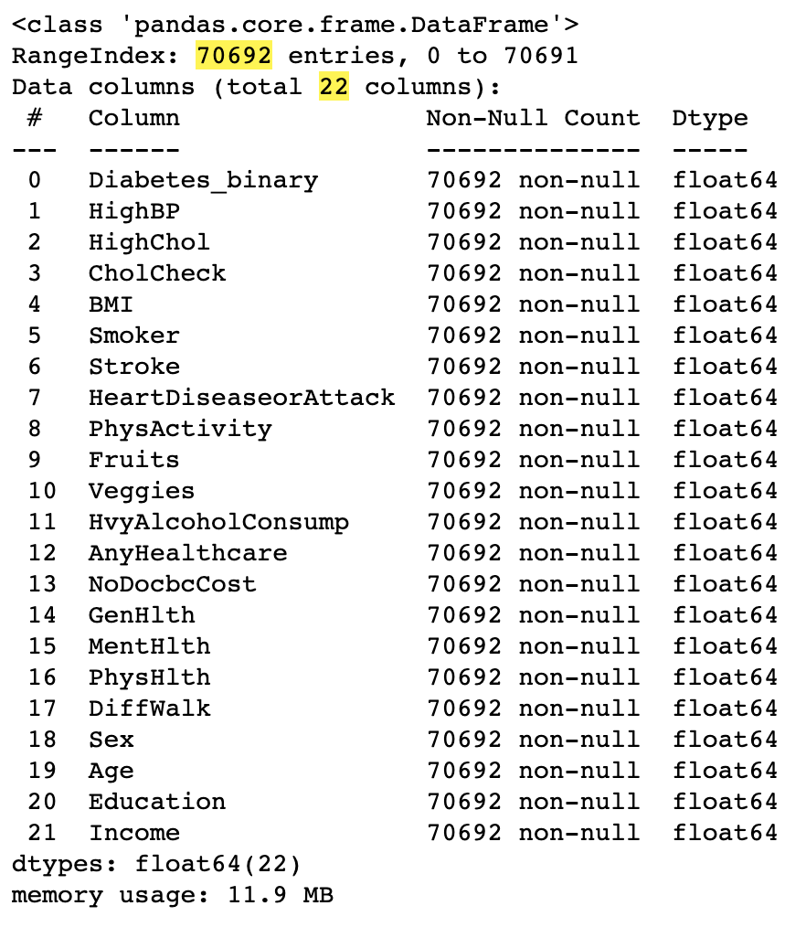
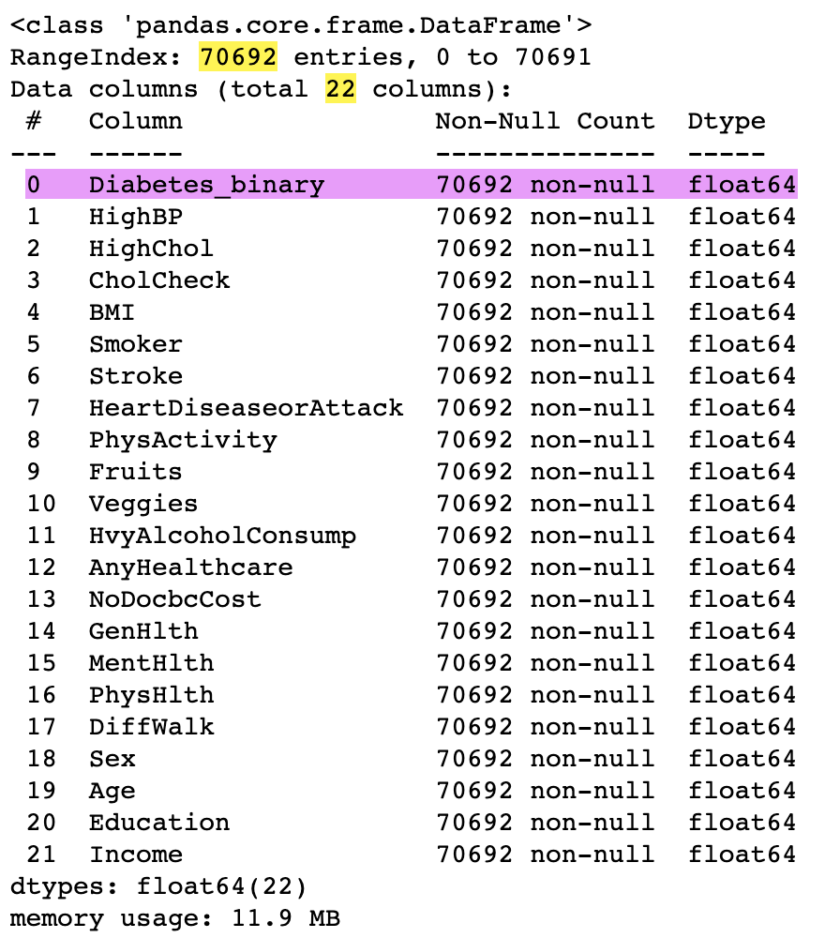
Raw Data
70692 samples
22 variables
21 Categorical Variables
1 Numerical Variable
Dataset from Kaggle : "Diabetes Health Indicators Dataset Notebook" by Alex Teboul
Notes:
Diabetes Health Indicators Dataset Notebook
ALEX TEBOUL
There are 22 variables/columns and 70692 samples/rows in the dataset.
The response variable seems to be Diabetes_binary, while the remaining 21 are most likely predictors.
All 22 variables are identified as float64 by default, but they are a mixed of 15 Categorical Variables and 7 Numerical Variables.
After inspection, none of the variables/features seem to have any missing value.

Slide 5
Response Variables
Diabetes
Surveyees ever have Diabetes

Slide 6


















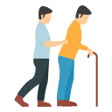

Predictor Variables
Lifestyle
Demographics
Health Condition
Fruits
Vegetables
Income
Education
Heart Disease
High Cholesterol
High Blood Pressure
Heavy Alcohol Consumption
Smoker
Age
BMI
General Health
Mental Health
Physical Health
Physical Activity
Avoid seeing doc due to cost
Sex
Healthcare Coverage
Difficulty Walking
Stroke

Slide 7
Data Cleaning and Preparation
Renaming Binary Data
Splitting Data
Test: 20%
1/0 → Y/N
1/0 → Y/N
Train: 80%
Normalising Dataset
Removing Outliers
Dataset already has has an equal
50-50
50-50
split of respondents with no diabetes and with either prediabetes or diabetes
Notes:
2.1 Renaming binary data
2.2 Normalising the dataset
Samples do not need to be normalised as the given data has been normalised to 50:50 for the response variable Diabetes_binary
2.3 Removing Outliers
To be continued after exploring of dataset
2.4 Spliting data into Training and Test Sets
Dataset will be split into 80% for training set and 20% for testing set

Slide 8
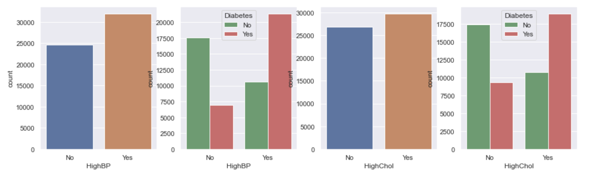
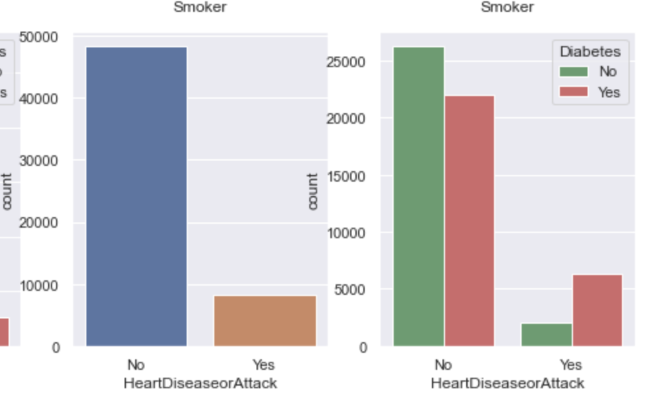
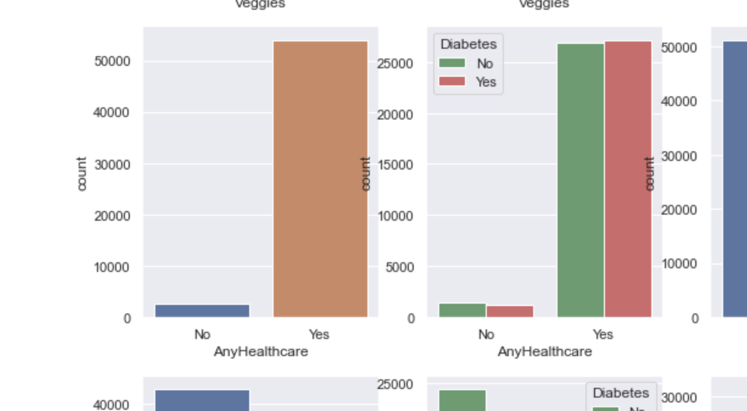
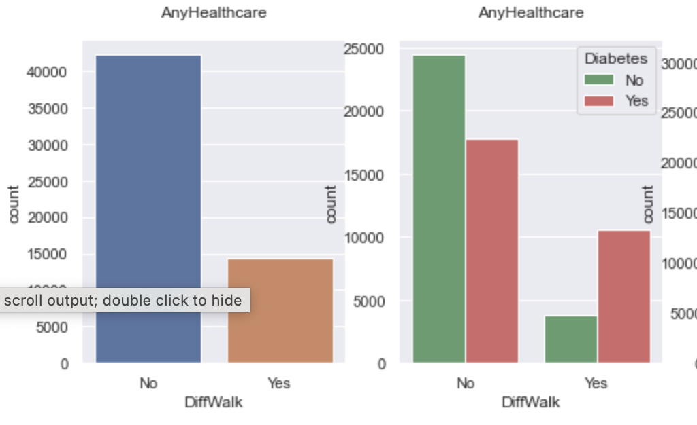
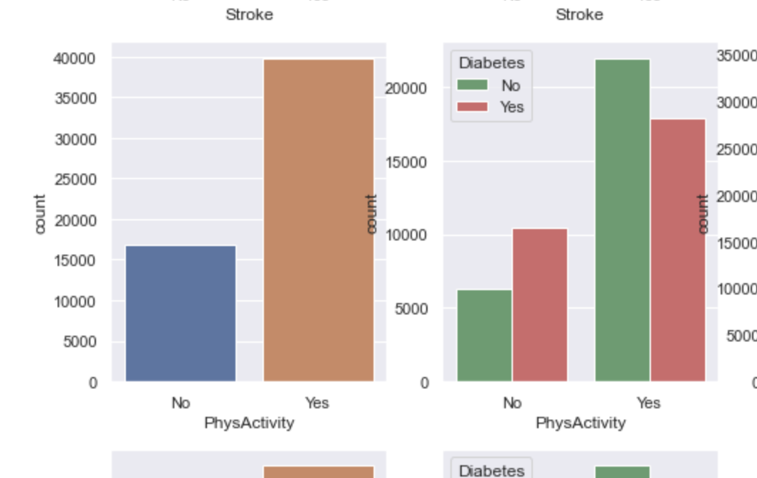
Exploratory Data Analysis
Strong Positive relationship
Weak Positive relationship
No relationship
Negative relationship

Slide 9
Relationship (Positive)
High Cholesterol
High Blood Pressure

Slide 10
Relationship (Positive)
Heart Disease
Difficulty Walking

Slide 11
Relationship (Negative)
Physical Activity

Slide 12
No Relationship
Healthcare Coverage

Slide 13
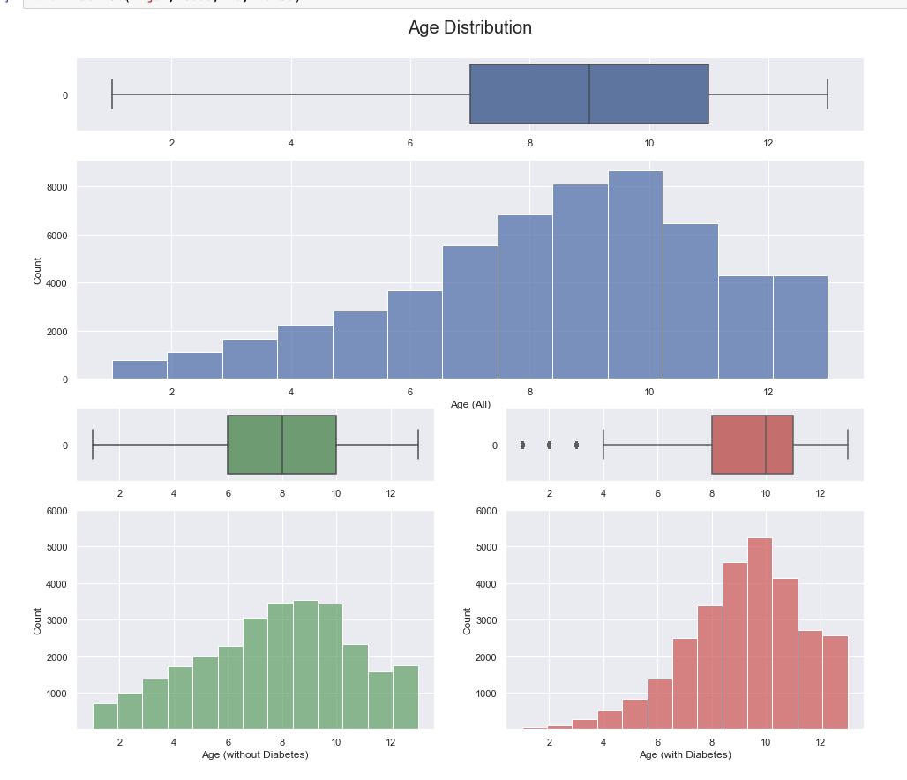
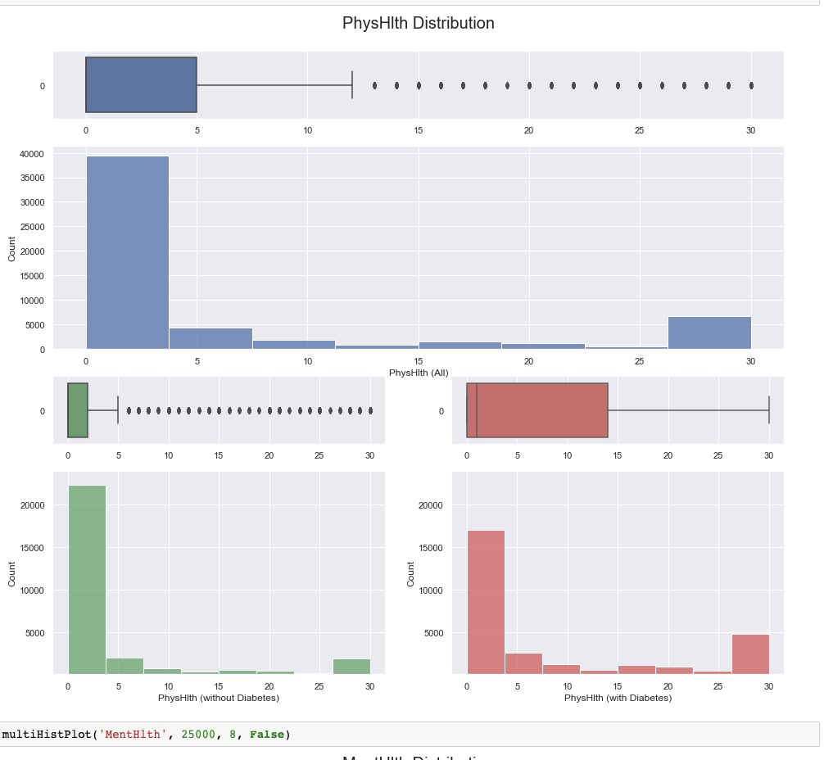
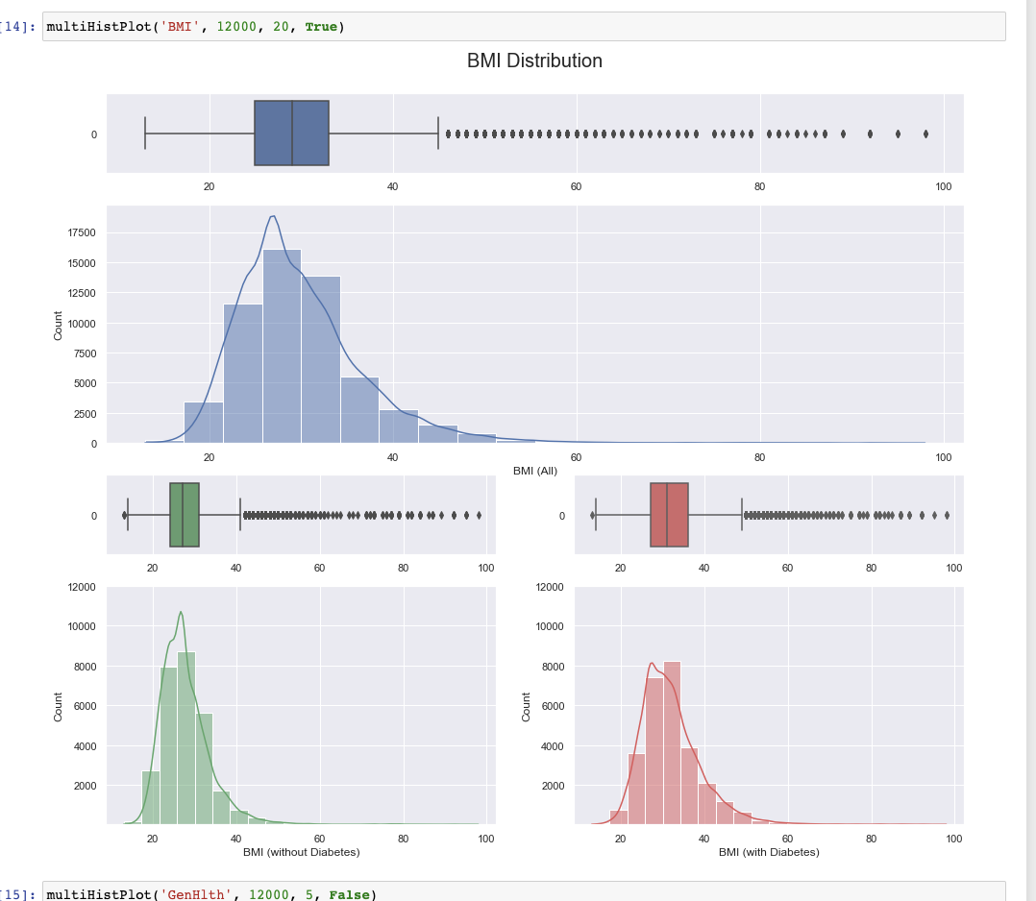
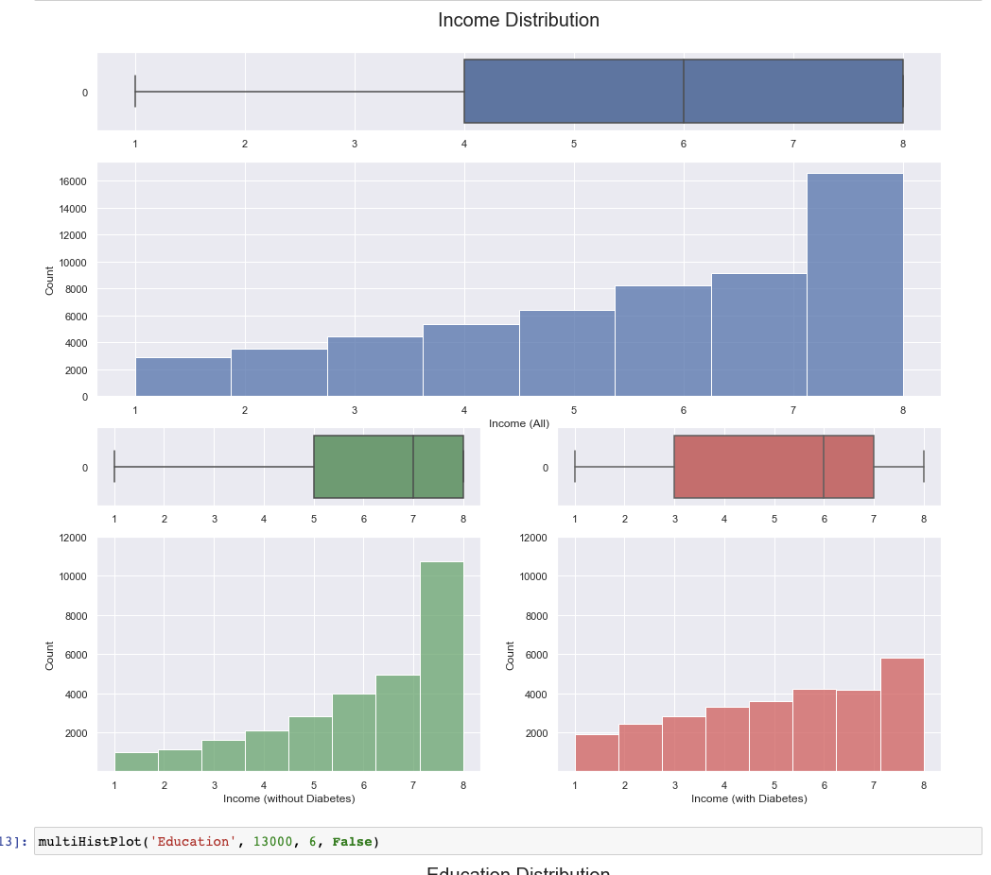
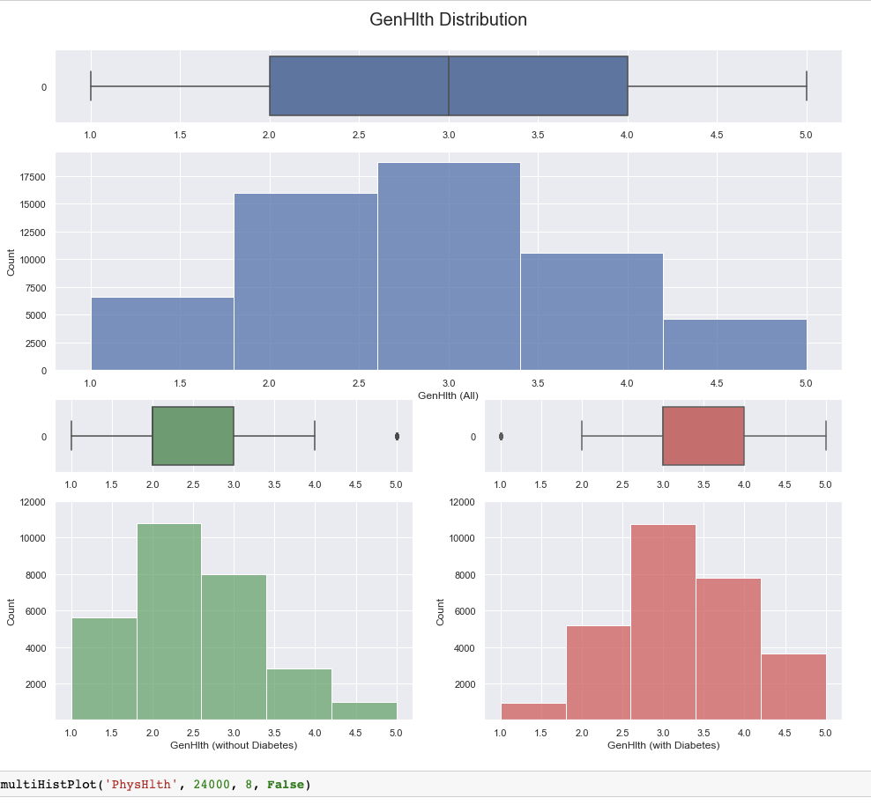
Exploratory Data Analysis
Visible/Strong correlation with diabetes

Slide 14
Visible/Strong Correlation with Diabetes
Age

Slide 15
Visible/Strong Correlation with Diabetes
Income

Slide 16
Visible/Strong Correlation with Diabetes
BMI

Slide 17
Visible/Strong Correlation with Diabetes
General Health

Slide 18
Visible/Strong Correlation with Diabetes
Physical Health

Slide 19
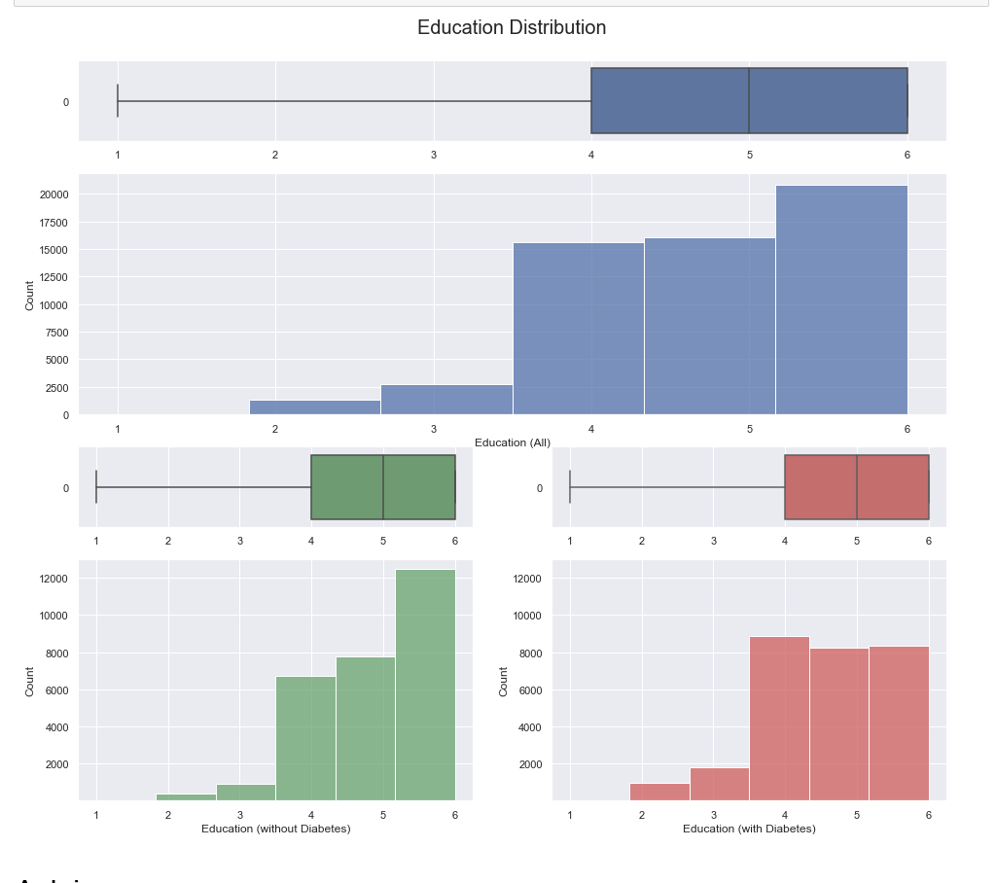
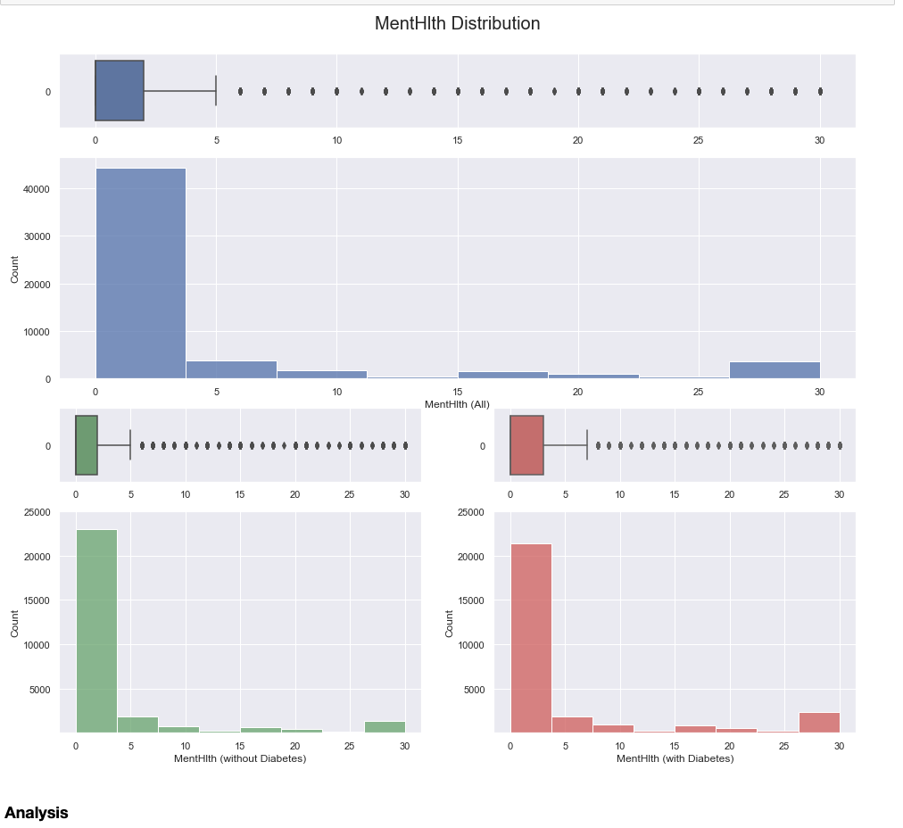
No visible/strong correlation with diabetes

Slide 20
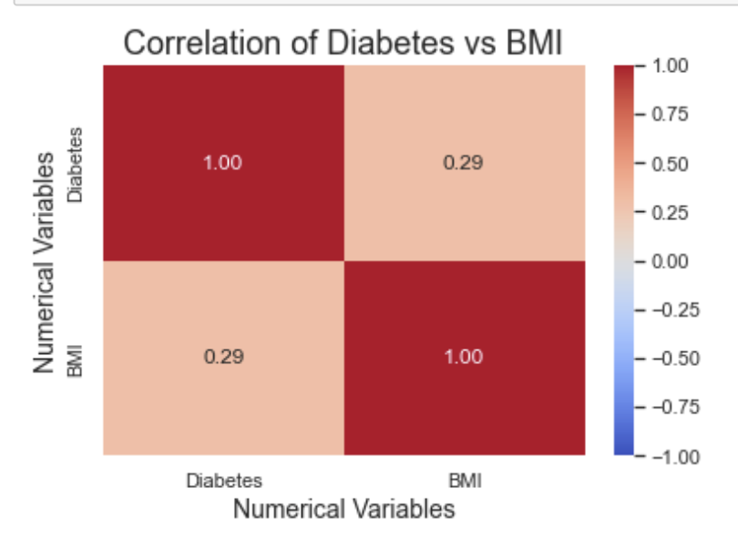
Pearson’s Correlation Matrix (BMI)
Only Numerical Variable
Moderate Positive Correlation with Diabetes

Slide 21
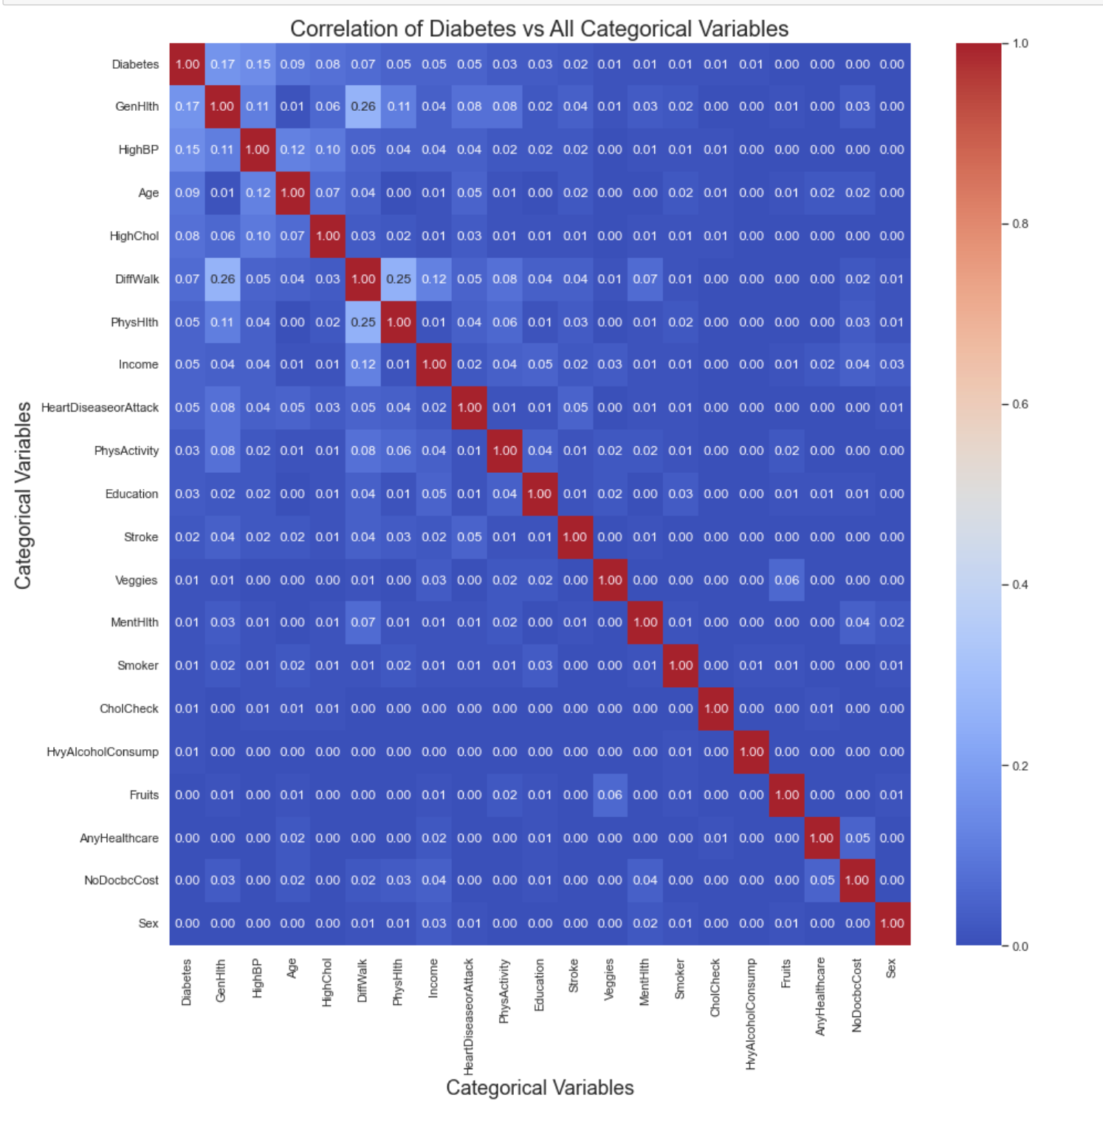
Cramer’s V Correlation Matrix

Slide 22

Overall Analysis from EDA
Crucial Risk Factors
Focusing On More Important Risk Factors Of Diabetes
HighBP, HighChol, HeartDiseaseorAttack, DiffWalk, PhysActivity, Age, Income, BMI, GenHlth, PhysHlth
Removing Outliers
High Cholesterol
Heart Disease
Age
BMI
General Health
Many outliers with unrealistic BMI values
Possibility of incorrect responses due to the different unit of weight assumed (eg. lbs vs kg) resulting in inaccurate BMI values
High Blood Pressure
Difficulty Walking
Physical Activity
Income
Physical Health
Always
thirsty
Notes:
Upon completing our EDA, we have also decided to Removing outliers before proceeding on further analysis
Based on our observation on the boxplot on the distribution of BMI, we realised that there are many outliers with BMI values that are impossible to obtain. Diving into closer look at the raw data from the data source, we realised that there could be a possibility that the surveyees have responded incorrectly in terms of the unit of the weight (eg. lbs vs kg) when computing the BMI values.
Therefore, we will be removing these outliers before proceeding on further analysis.

Slide 23
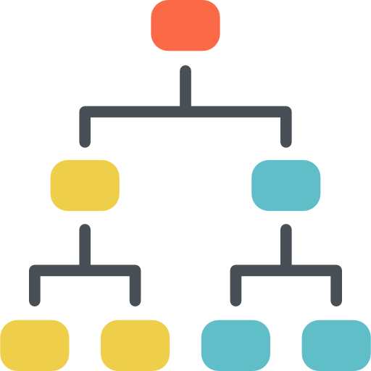
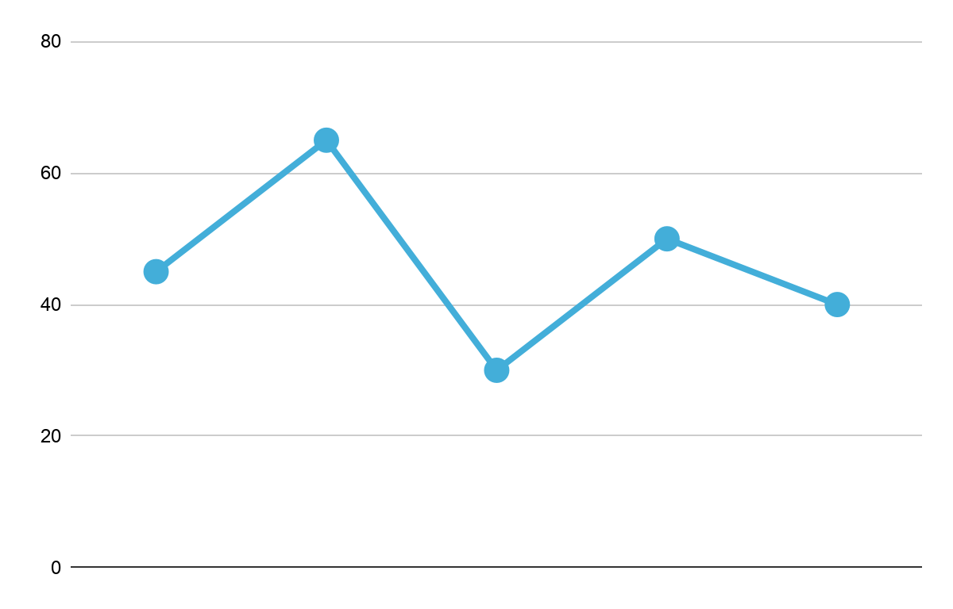
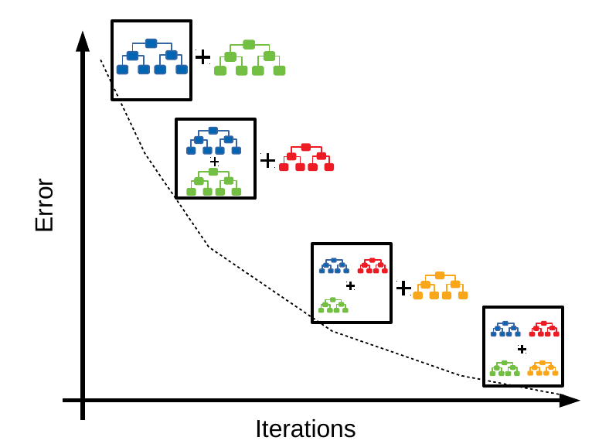
Machine Learning
Decision Tree
Gradient Boosting
Dataset
Random Forest
Majority Voting + Final Class
Notes:
Decision Trees (DTs) are a non-parametric supervised learning method used for classification and regression. The goal is to create a model that predicts the value of a target variable by learning simple decision rules inferred from the data features.
Random forest is a Supervised Machine Learning Algorithm that is used widely in Classification and Regression problems. It builds decision trees on different samples and takes their majority vote for classification and average in case of regression
Gradient boosting is a machine learning technique used in regression and classification tasks, among others. It gives a prediction model in the form of an ensemble of weak prediction models, which are typically decision trees.^{[1][2]} When a decision tree is the weak learner, the resulting algorithm is called gradient-boosted trees; it usually outperforms random forest.^{[1][2][3]} A gradient-boosted trees model is built in a stage-wise fashion as in other boosting methods, but it generalizes the other methods by allowing optimization of an arbitrary differentiable loss function.

Slide 24
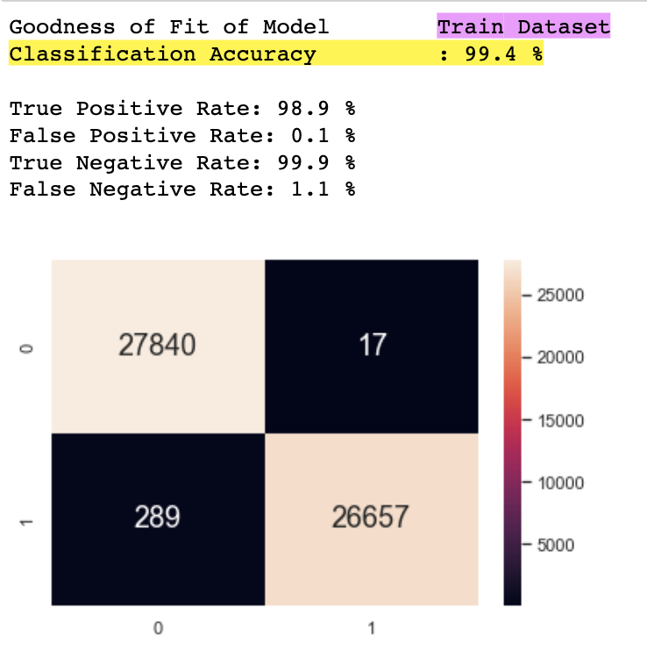
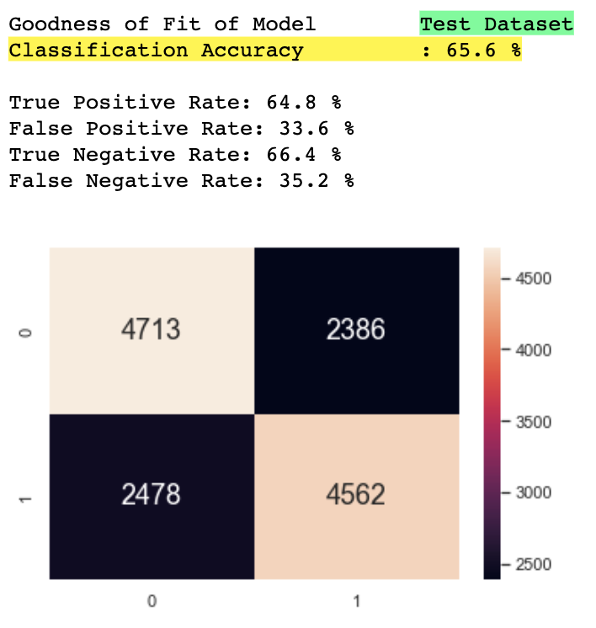
Decision Tree
Evaluation

Slide 25

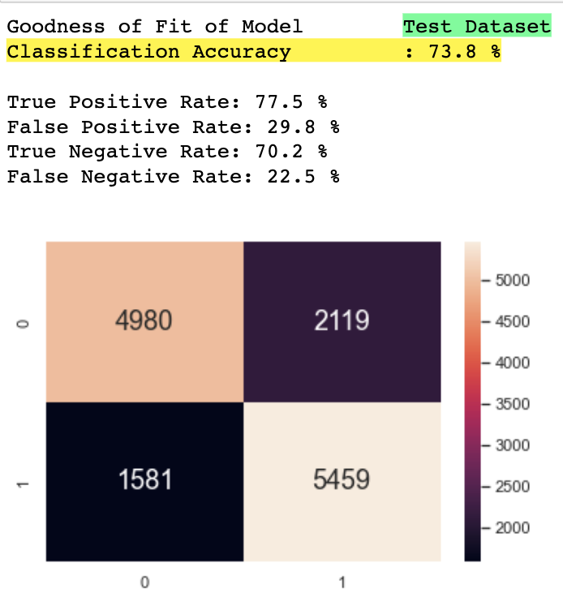
Random Forest Model
Evaluation

Slide 26
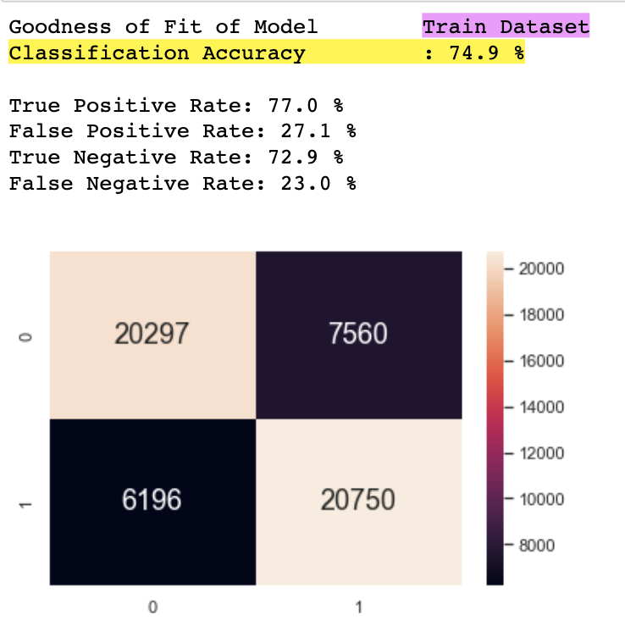
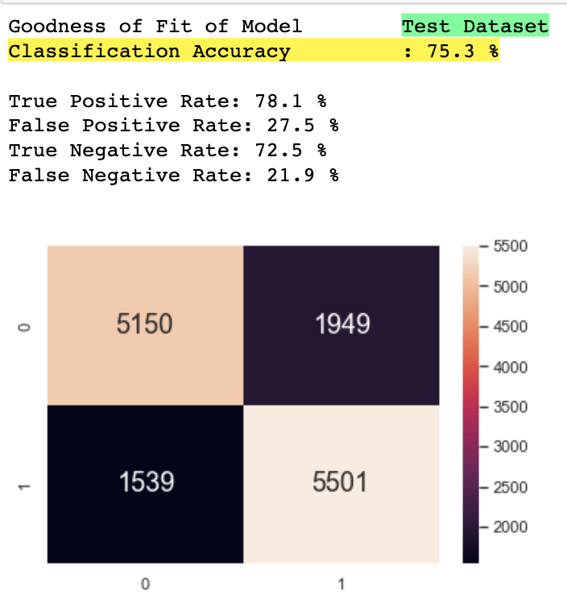
Gradient Boosting
Evaluation

Slide 27
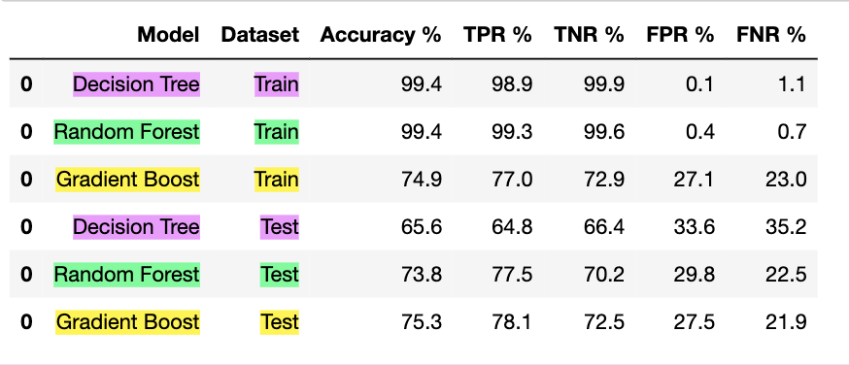
Comparison (Train vs Test) - Old Model
Decreased
Increased
Notes:
After running the models on the test dataset, we can see that for Decision Tree and Random Forest, the Accuracy, TPR and TNR have decreased significantly while FPR and FNR have also increased significantly.
This shows that these 2 models have overfitted to our training dataset. This is because the performance on the training dataset is improved at the cost of worse performance on test dataset.

Slide 28
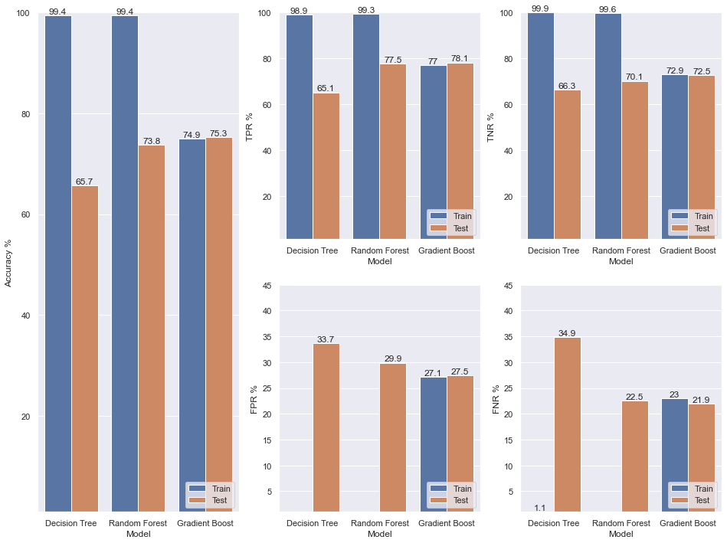
Comparison (Train vs Test)
Old Model
Train Dataset
Test Dataset
Notes:
We can see that for Decision Tree and Random Forest, the Accuracy, TPR and TNR have decreased significantly and FPR and FNR have also increased significantly.
This shows that these 2 models have overfitted to our training dataset. This is because the performance on the training dataset is improved at the cost of worse performance on test dataset.

Slide 29
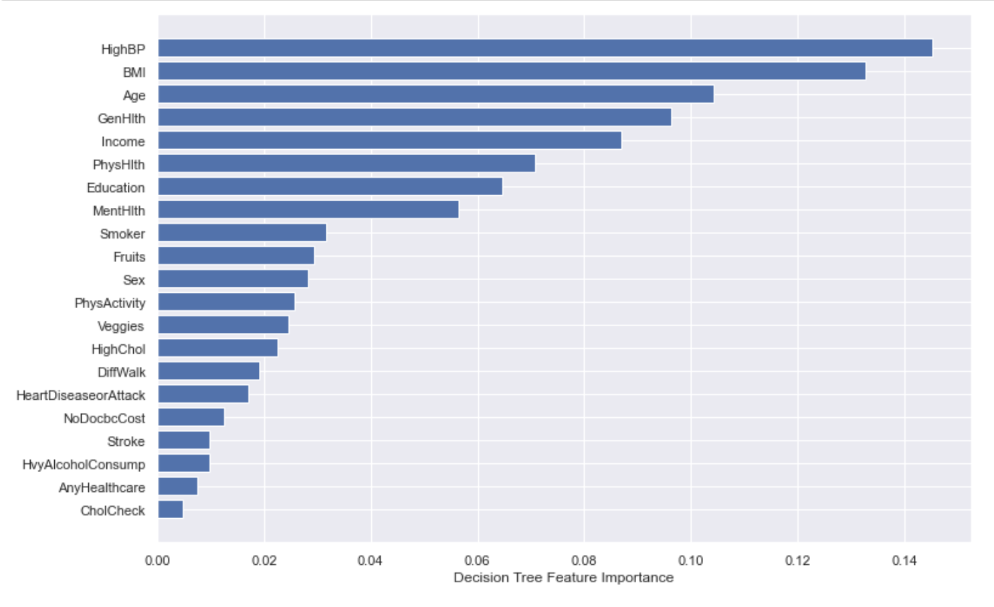
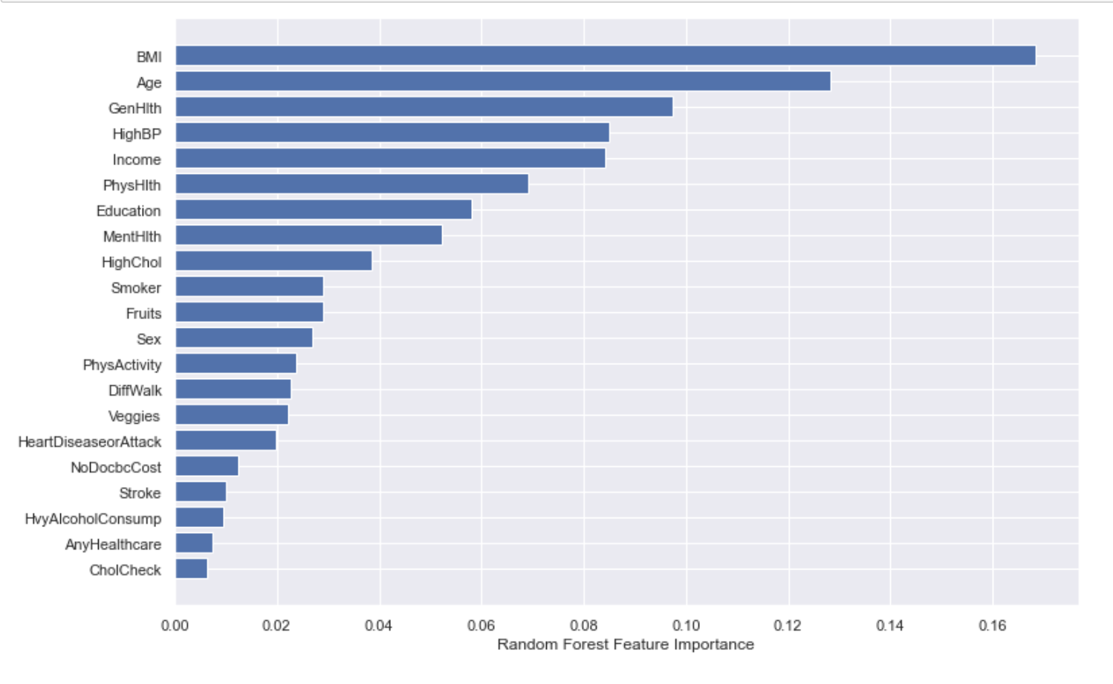
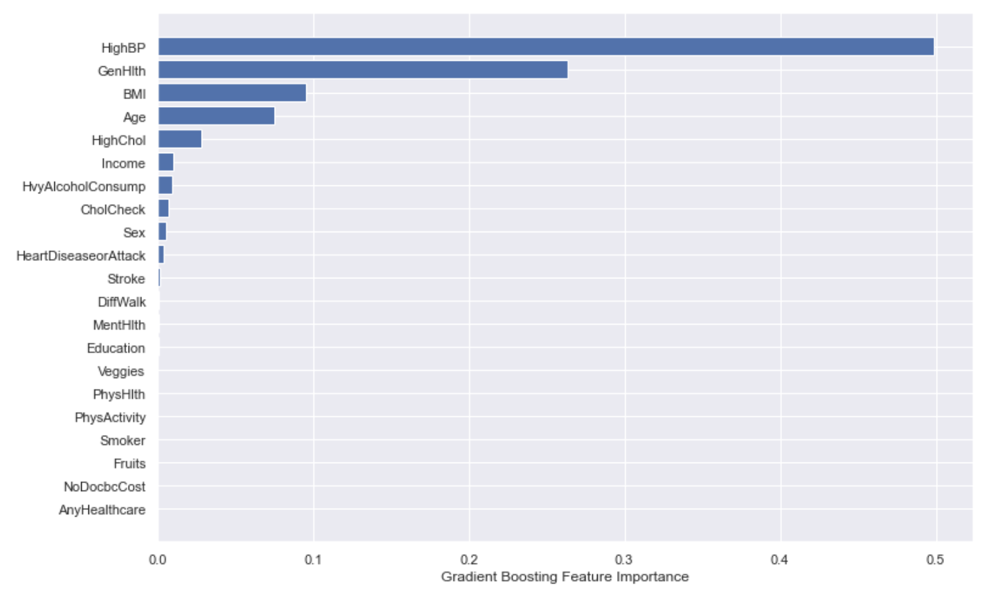
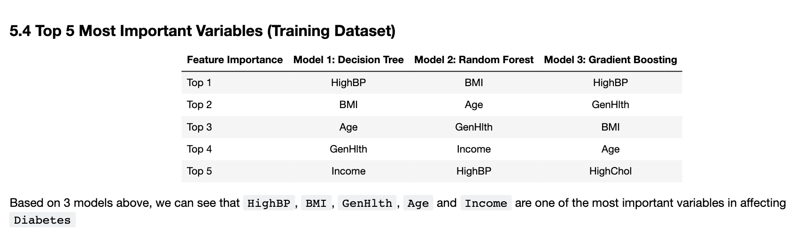
Feature Importance
Decision Tree
Random Forest
Gradient Boosting

Slide 30
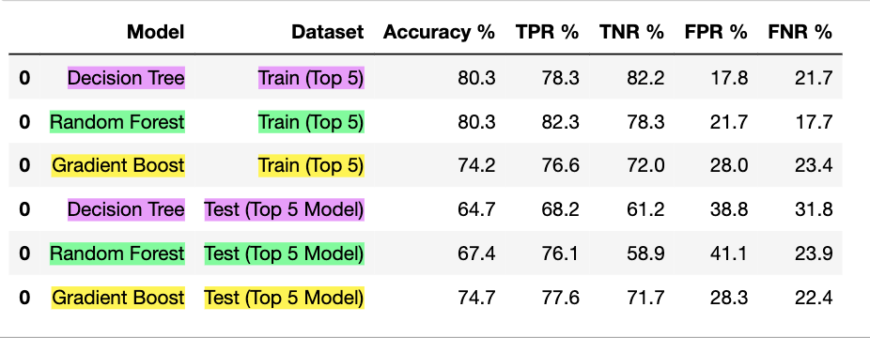
Comparison (Train vs Test) - New Model
Notes:
Since we have deduced the most important variables in affecting diabetes using the models, we will re-train the models using only these variables instead of all variables to reduce overfitting issues.
After running the new model on the test dataset, we can see that there is the differences between Train vs Test in each metrics is not as significant as the previous model, this shows that we have improved the model performance by reducing overfitting issues.

Slide 31
Comparison (Train vs Test)
Old Model
Train Dataset
Test Dataset
Notes:
We can see that for Decision Tree and Random Forest, the Accuracy, TPR and TNR have decreased significantly and FPR and FNR have also increased significantly.
This shows that these 2 models have overfitted to our training dataset. This is because the performance on the training dataset is improved at the cost of worse performance on test dataset.

Slide 32
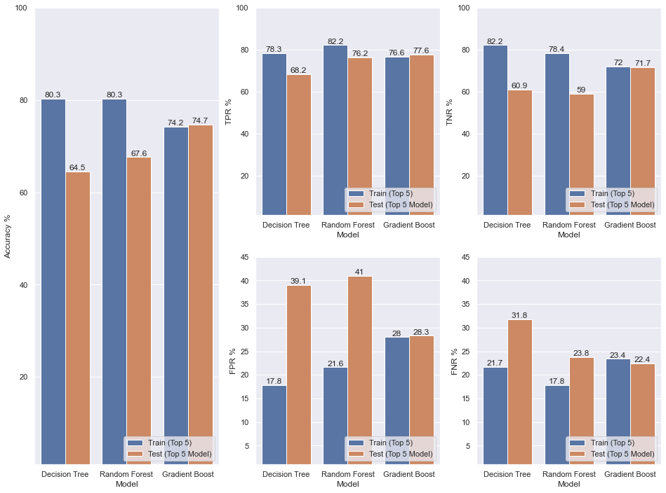
Comparison (Train vs Test)
New Model
Train Dataset
Test Dataset
Notes:
Since we have deduced the most important variables in affecting diabetes using the models, we will re-train the models using only these variables instead of all variables to reduce overfitting issues.
After running the new model on the test dataset, we can see that there is the differences between Train vs Test in each metrics is not as significant as the previous model, this shows that we have improved the model performance by reducing overfitting issues.

Slide 33
Conclusion
Top Predictor Variables
High Blood Pressure
High Cholesterol
Income
BMI
General Health
Age

Slide 34
Learning Outcomes
8.5
What We Learned
Data Driven Insights
Cramer’s V Correlation Matrix
Random Forest
Gradient Boosting
To reduce the risk of diabetes:
Monitor BMI, General Health, Cholesterol Level & Blood Pressure
Include a healthy amount of physical exercise + balanced nutritional intake
Problem Solving
*Dataset includes Type 1 & Type 2 diabetes
Type 1 - Genetic Condition
Type 2 - Mainly Lifestyle-related
& develops over time
Through Feature Importance
Determine and Extract Crucial Factors
Reduce Overfitting Issues In Models
Notes:
From this project, we learned new EDA techniques like Cramer’s V correlation matrix to understand the strength of the relationship between categorical variables. We also learned how to use different machine learning models, such as random forest as well as gradient boosting for classification models.
We learned how to extract and focus on the more important variables to reduce the overfitting issues in our classification models. Through the use of the feature importances of each model, we were able to determine which factors were more crucial in predicting the response variable.
Through our findings, we learnt that there are certain factors that we can focus on so as to reduce the risk of diabetes. Such factors that we can monitor would be our BMI, general health, cholesterol and blood pressure. Measures that we could take include a healthy amount of physical exercise and a balanced nutritional intake. Monitoring our cholesterol level and blood pressure would also shed light on how healthy our current eating habits are and whether we are at risk of diabetes.
However, we should not just rely on these factors as the only guide to prevent diabetes as this dataset includes surveyees who ever had Type 1 or Type 2 diabetes which may affect the accuracy and reliability of the dataset.

Slide 35
Thanks!
Please keep this slide for attribution

